Slide 1



Kickstart your career with
Web
Nivetha Maran
Senior Software Engineer , Fourkites
GDG & WTM Chennai Ambassador
India

Slide 2
State Of Web In
India

Slide 3
India has Second Largest User-Base
580 MILLION
Internet Users

Slide 4
Challenges & Opportunities

Slide 5
Challenges

Slide 6
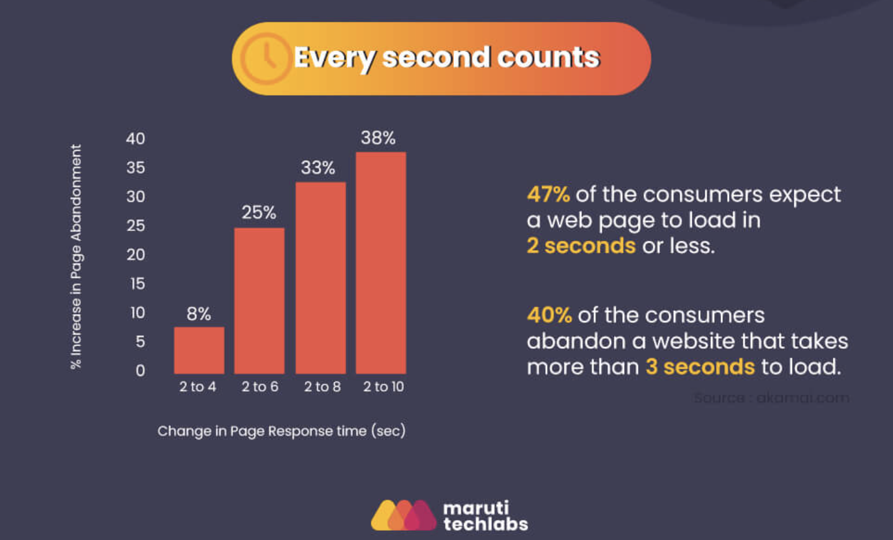

Slide 7
Performance
Scalability
User Experience
Security
Being updated with Frameworks and other web technologies

Slide 8
Opportunities

Slide 9
One of the Most In-Demand Tech Skills
2021

Slide 10
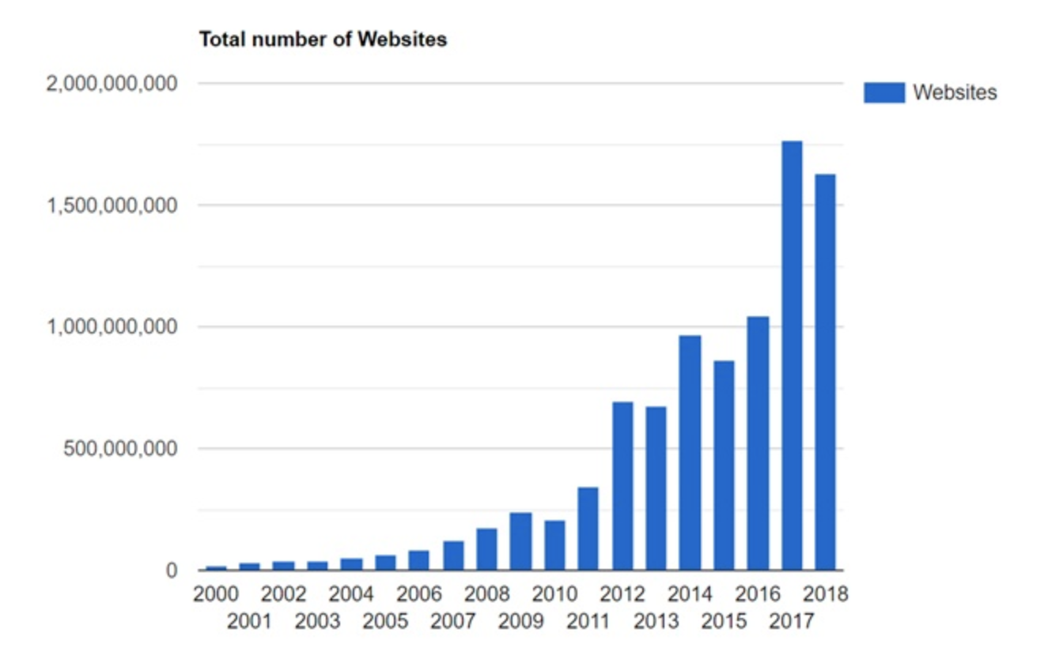

Slide 11
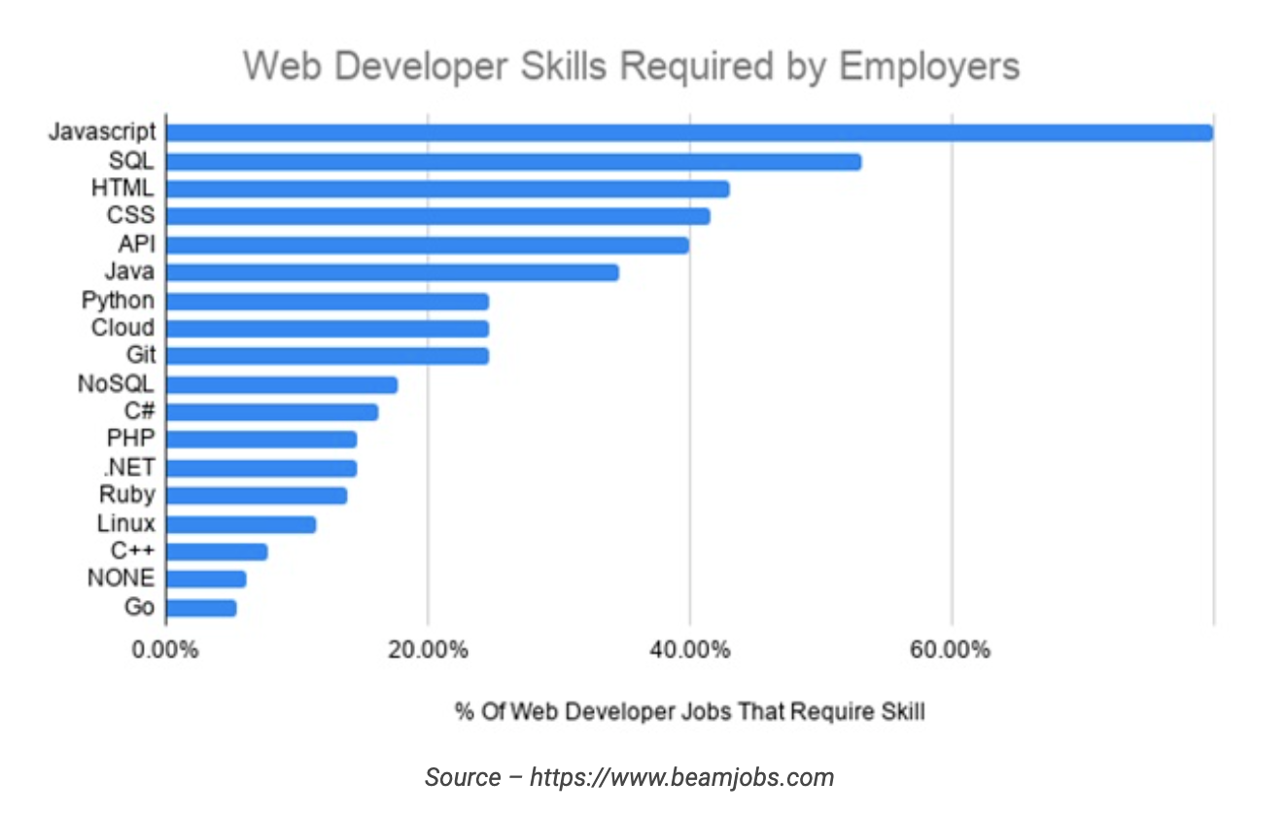

Slide 12
Roadmap for Web Developers

Slide 13

Start
HTML & CSS
Javascript
Package Managers
Build Tools,
Task Runners
Frameworks
Testing
PWA & AMP
End

Slide 14
How Google is helping Web Developers

Slide 15
Some of the main technologies
Angular
AMP Pages
Firebase
TensorFlowJS and etc

Slide 16


Slide 17


Slide 18


Slide 19


Slide 20
Getting Started with E-commerce app

Slide 21
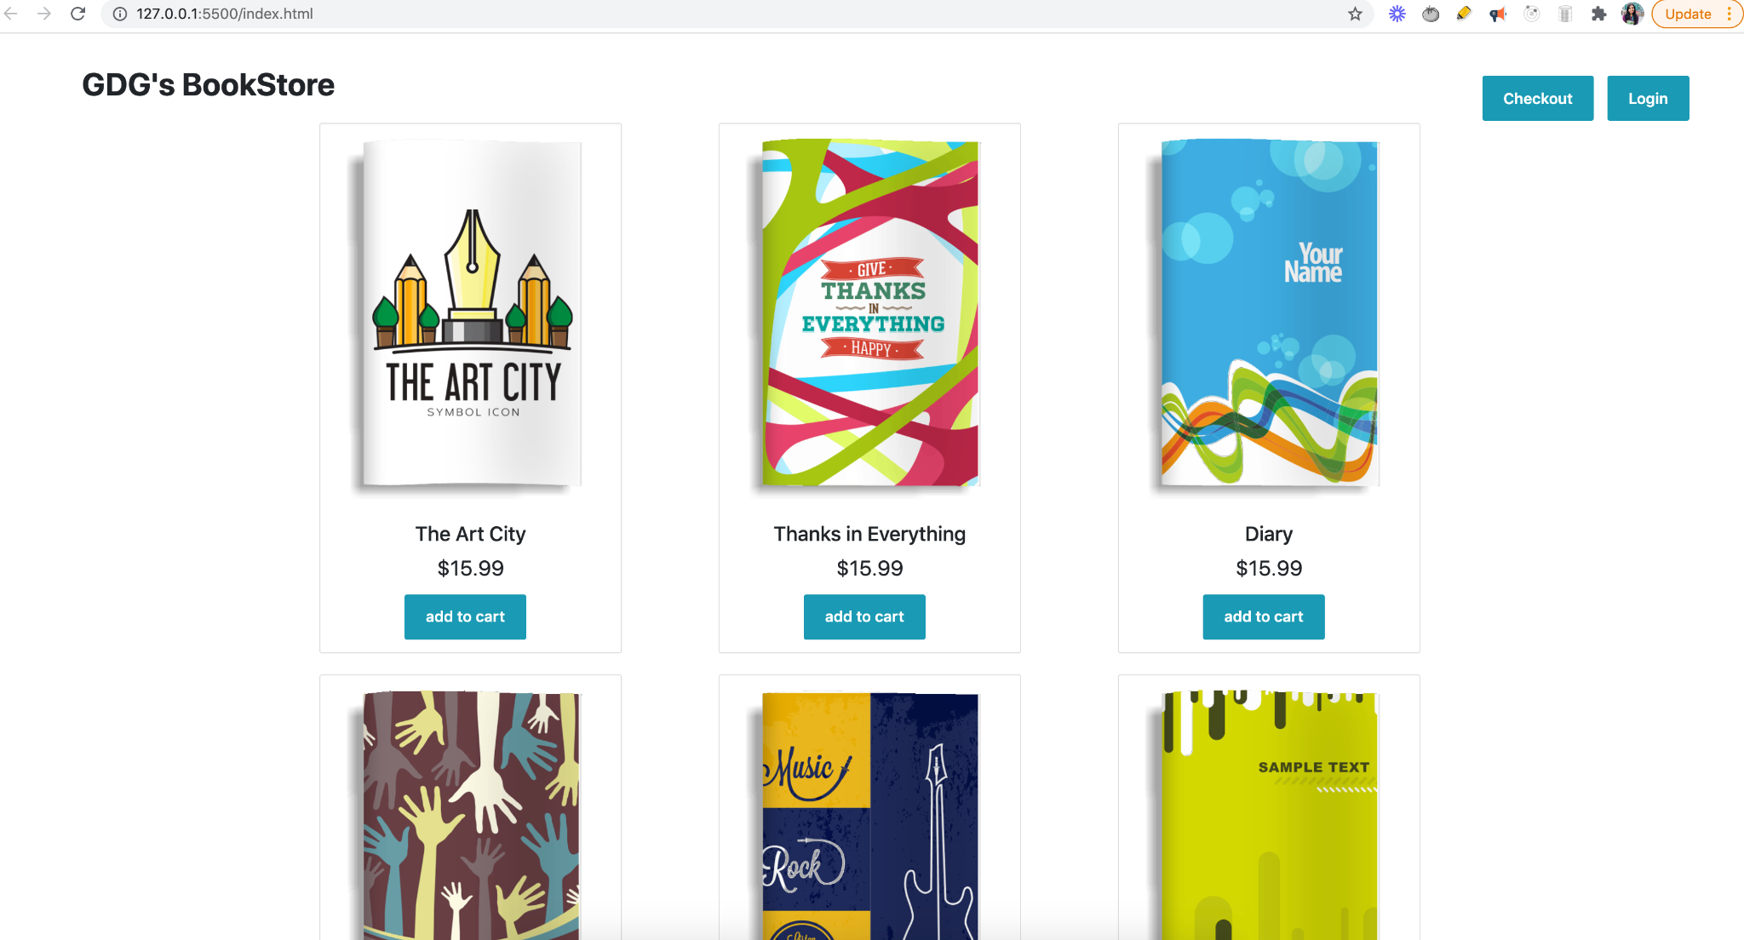

Slide 22
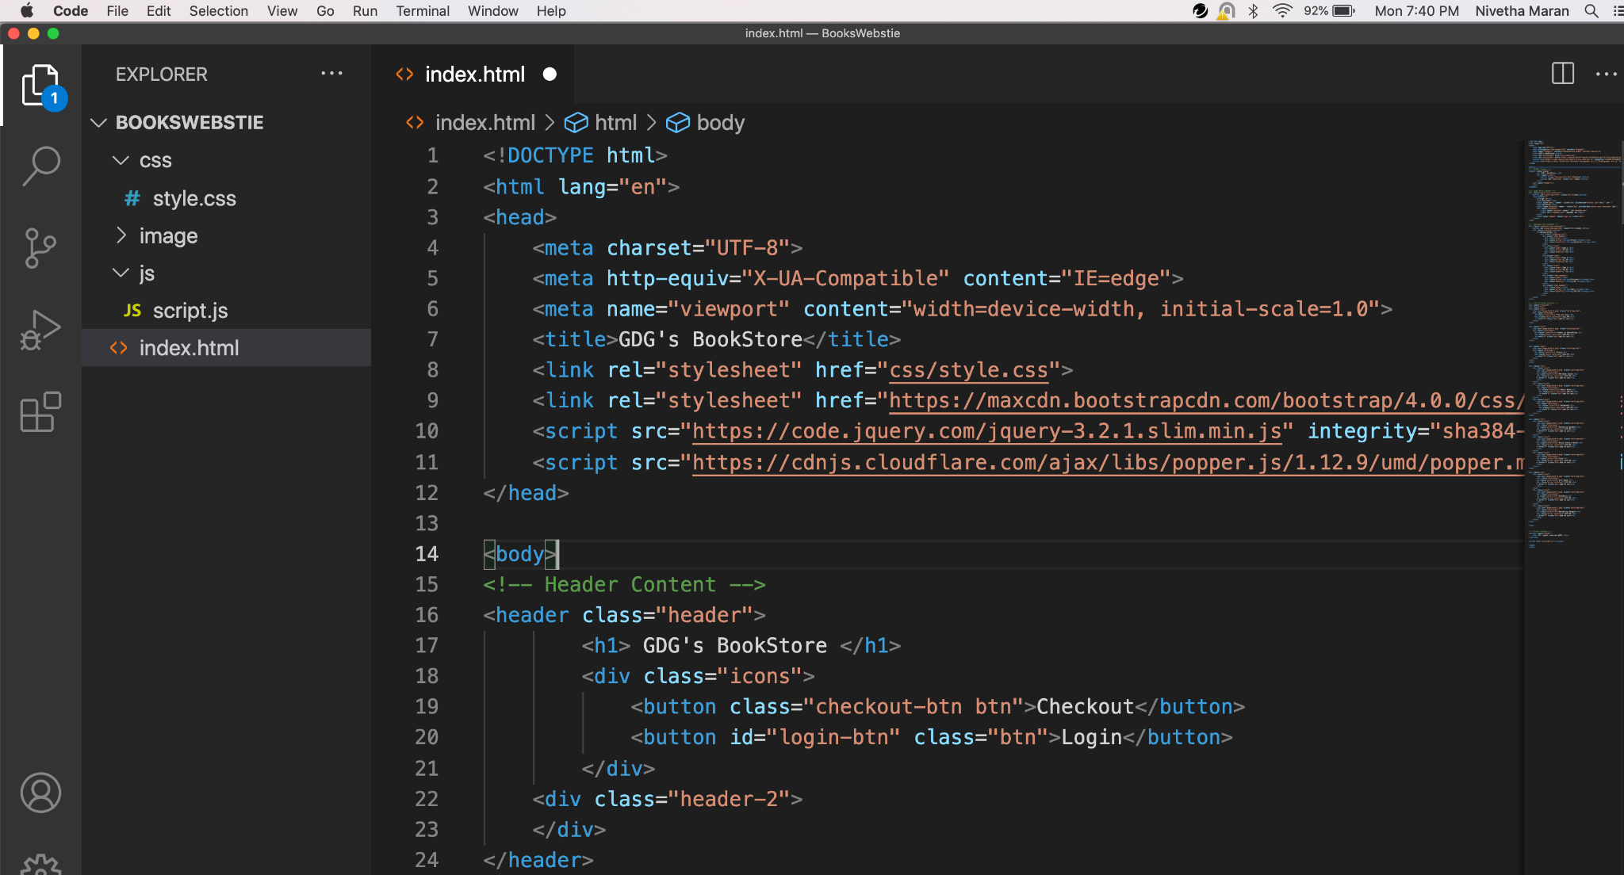

Slide 23
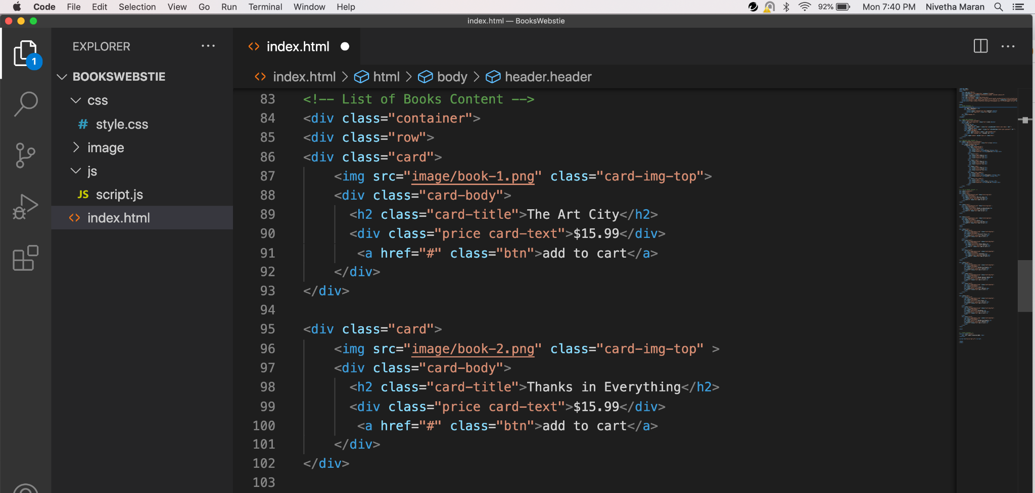

Slide 24
Replacing with AMP

Slide 25
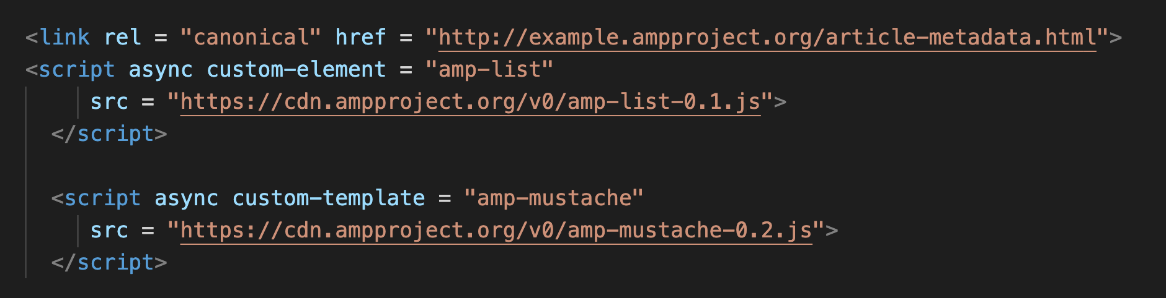
Adding Necessary AMP Tags

Slide 26
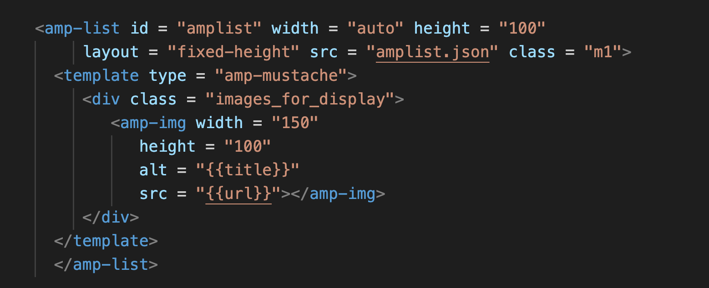
Replacing with AMP-list

Slide 27
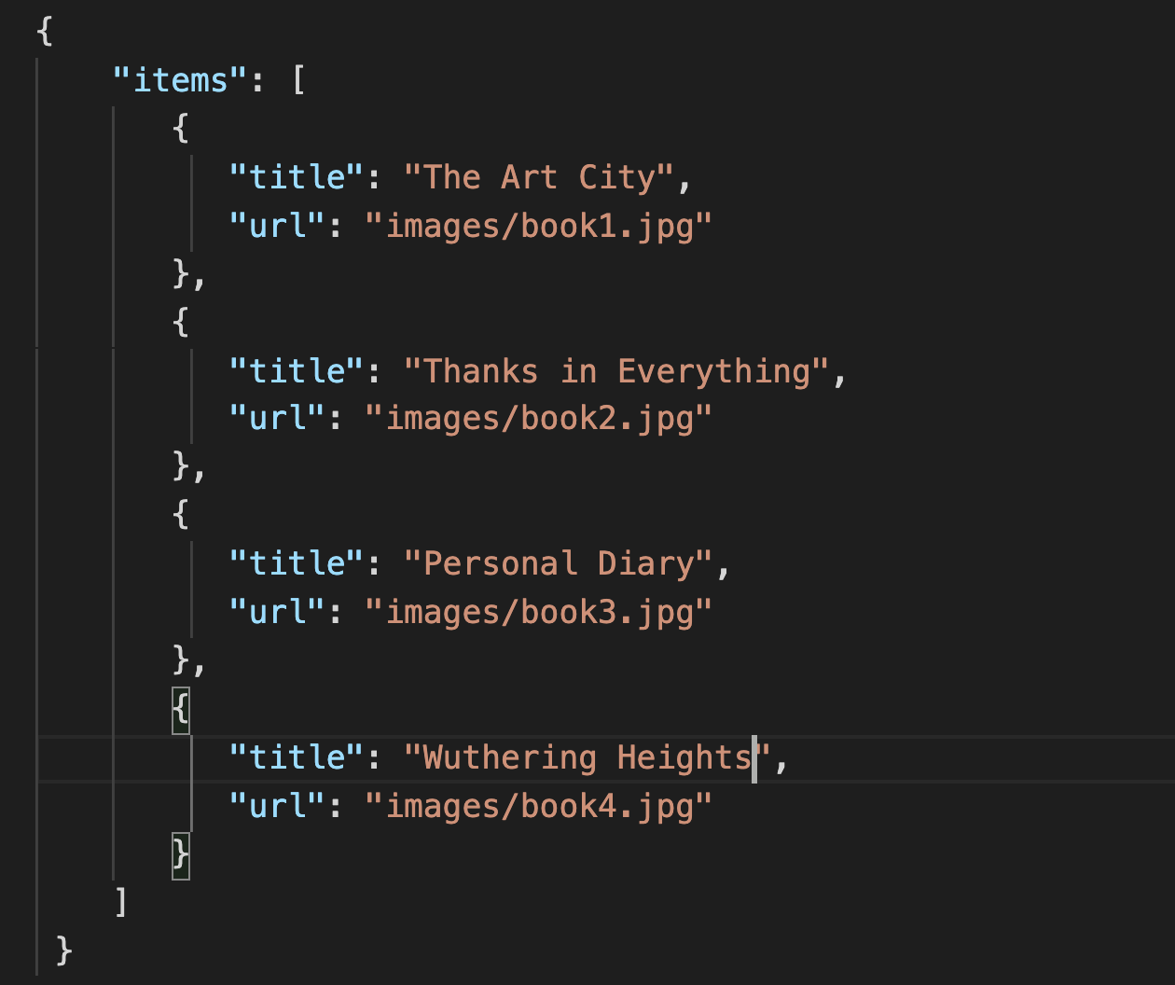
Sample JSON Data

Slide 28
What's Waiting for You in upcoming sessions ?

Slide 29
Frequently Asked Questions

Slide 30
Which framework to choose ?
How to get started with Angular and what are some of the useful resources ?
Can a Frontend developer transition to full stacker without much difficulty ?
What are the main uses of AMP?
What are the advantages of Angular when compared to other famous frameworks like React ?

Slide 31
Thank You !

